Slide 1
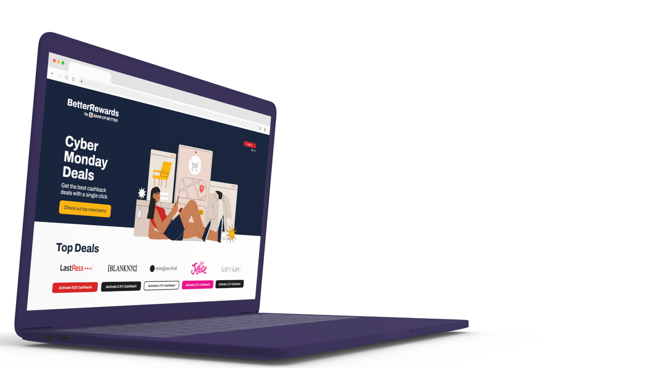

Citi QA Q2 Report
Notes:
current colors

Slide 2
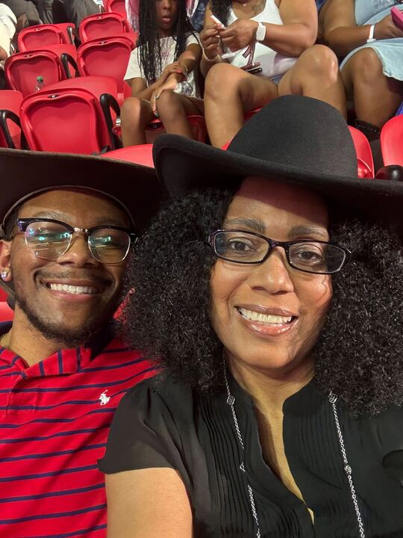
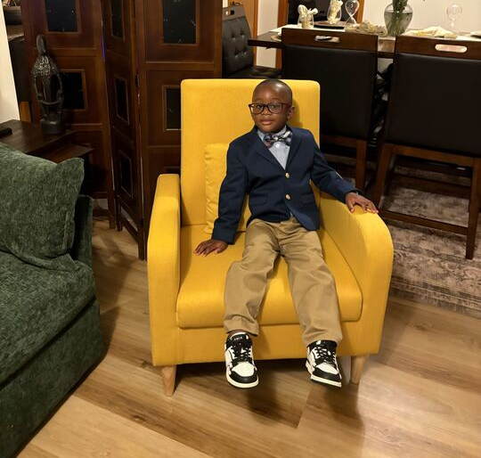
About Me!
Neil Jones
QA Analyst
POSITION
Winston-Salem, NC
LOCATION
🍿🏋🏻‍♂️🎳🎮
HOBBIES
Notes:
For emojis you can copy/paste to use in this slide, go here: https://getemoji.com/. Copy/paste the emojis you want and change the size by highlighting the emojis and adjusting the font size.

Slide 3
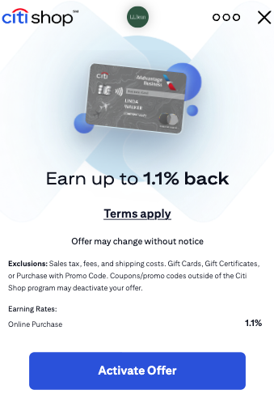
What does QA mean for WF?
Quality Assurance for WF is ensuring that the user is able to have a seamless shopping experience.
From when the user sees the Offer wall, to activating the offer, and validating there are no mishaps through the process.

Slide 4
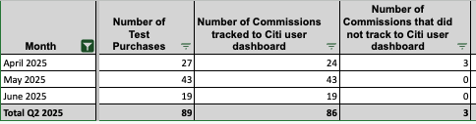
CITI Q2 Test Purchases
In Q2, the test purchase track percentage was 96%!!! With 2/3 test purchases that didn’t track, being from the same merchant.
Notes:
Update merchant picture

Slide 5
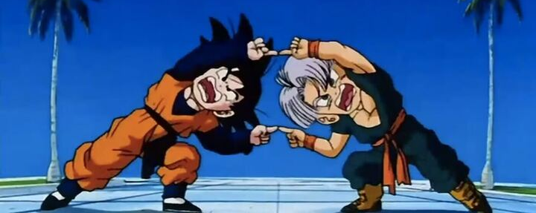
Collaboration Work
Amazon Conquesting
Stand-down Compliance Testing
Test purchases using manually created Wildlinks for each network
Project sAIge (AI Injection on ChatGPT Response)

Slide 6
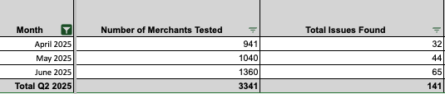
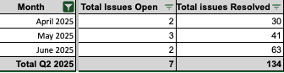
EMA Testing
Recap

Slide 7
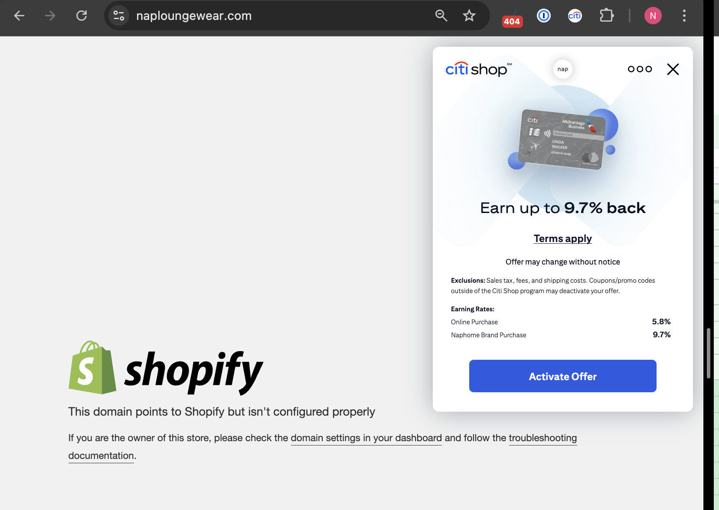
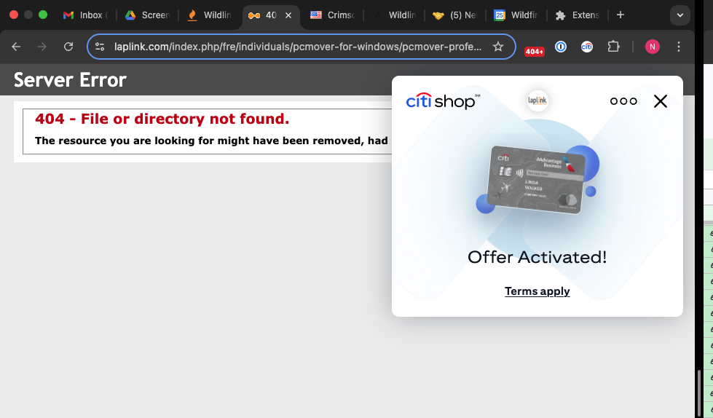
Q2 Findings
Merchants were still live in Citi, but the merchants had went out of business.
Selling excluded products.
Issues when activating offer.
When you land on a website, the EMA would either not be able to open at all, or it would open for a second and then close.
Links being updated/changed and needing to be added to Citi feeds.

Slide 8
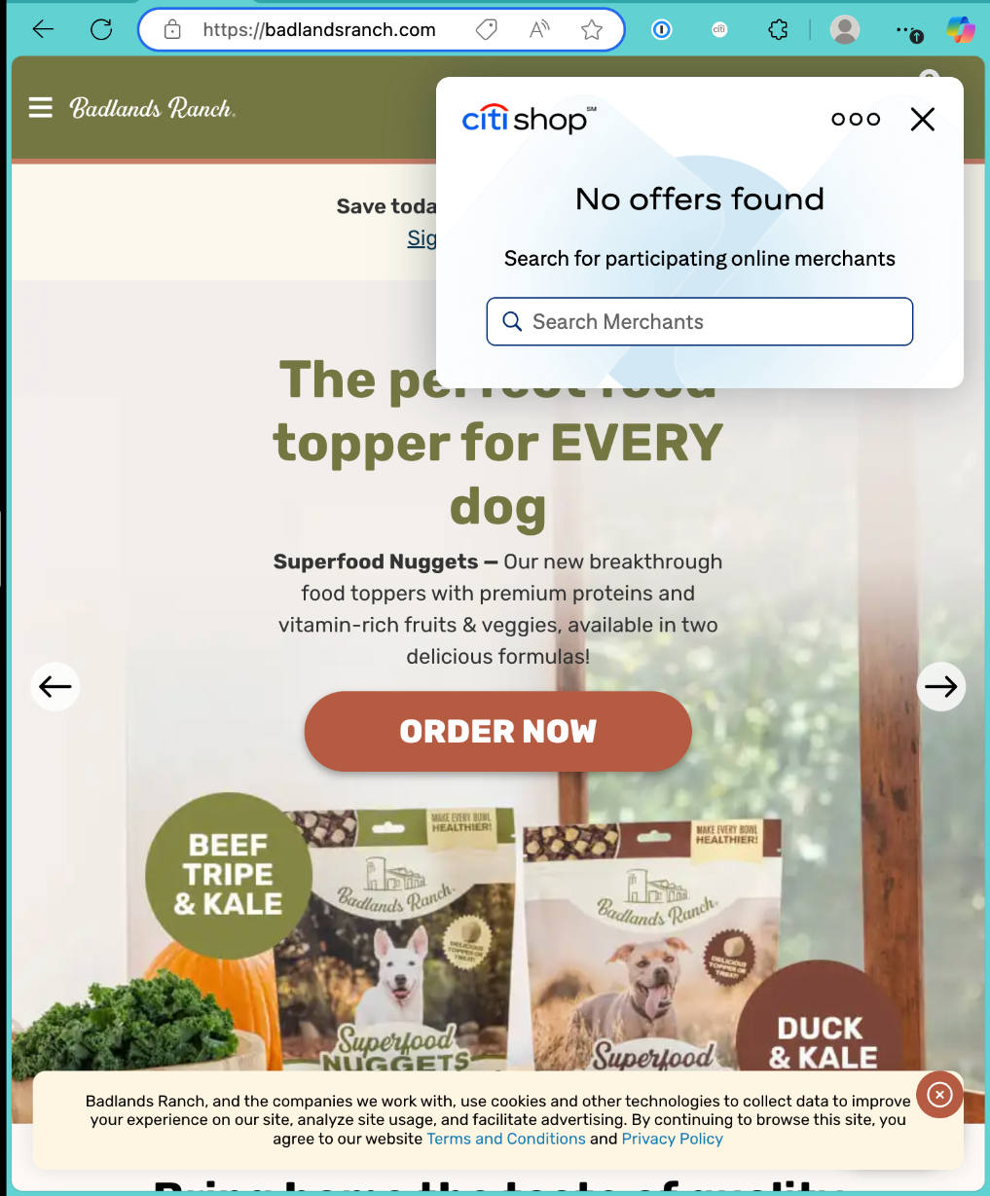
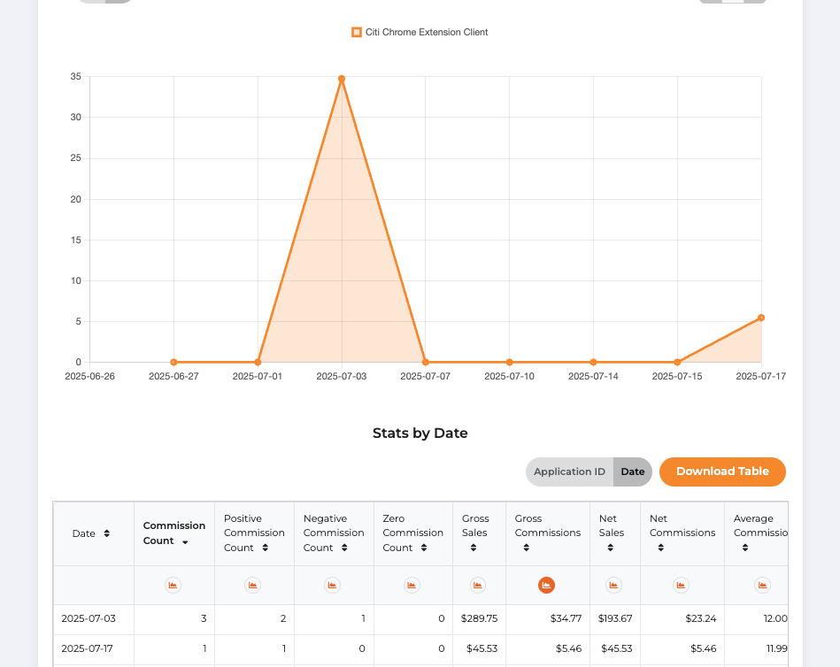

Slide 9
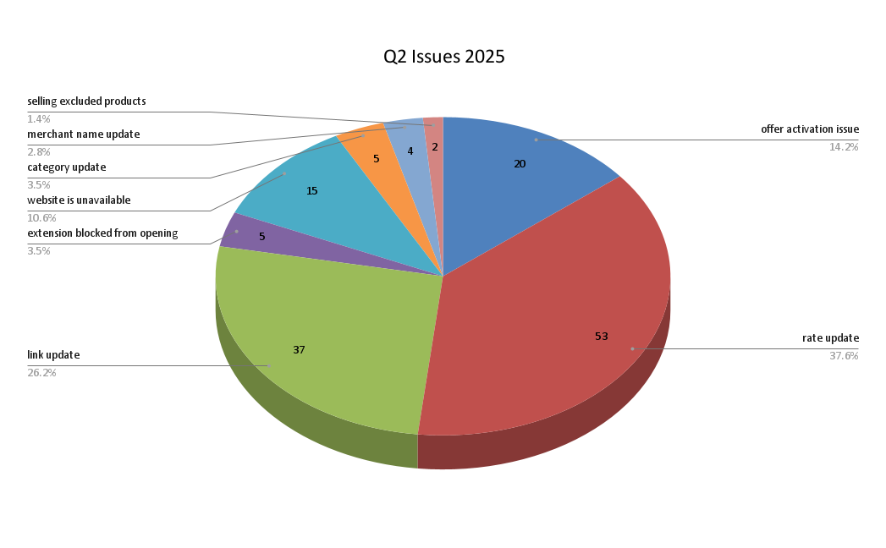
In-depth Chart

Slide 10
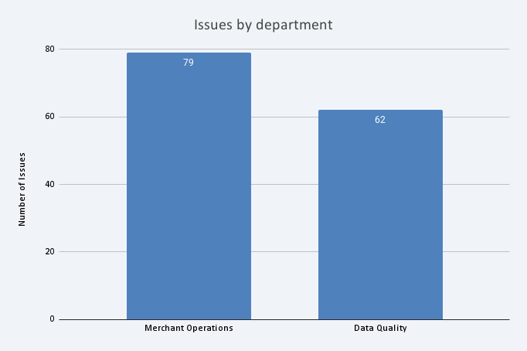

Slide 11
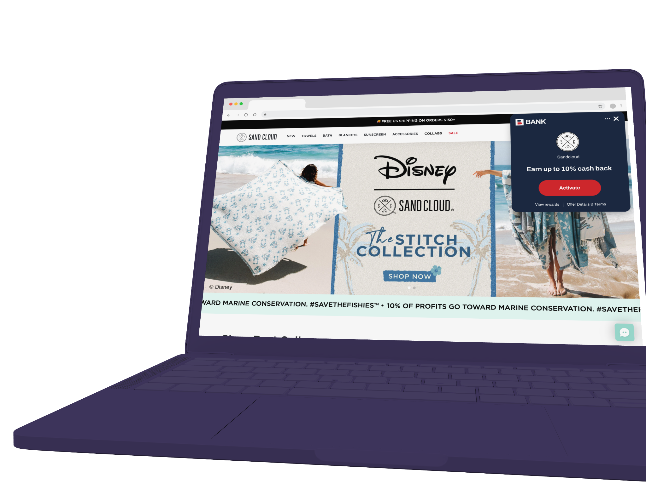
THANK YOU
Continue the conversation with neil.jones@wildfire-corp.com

